Slide 1
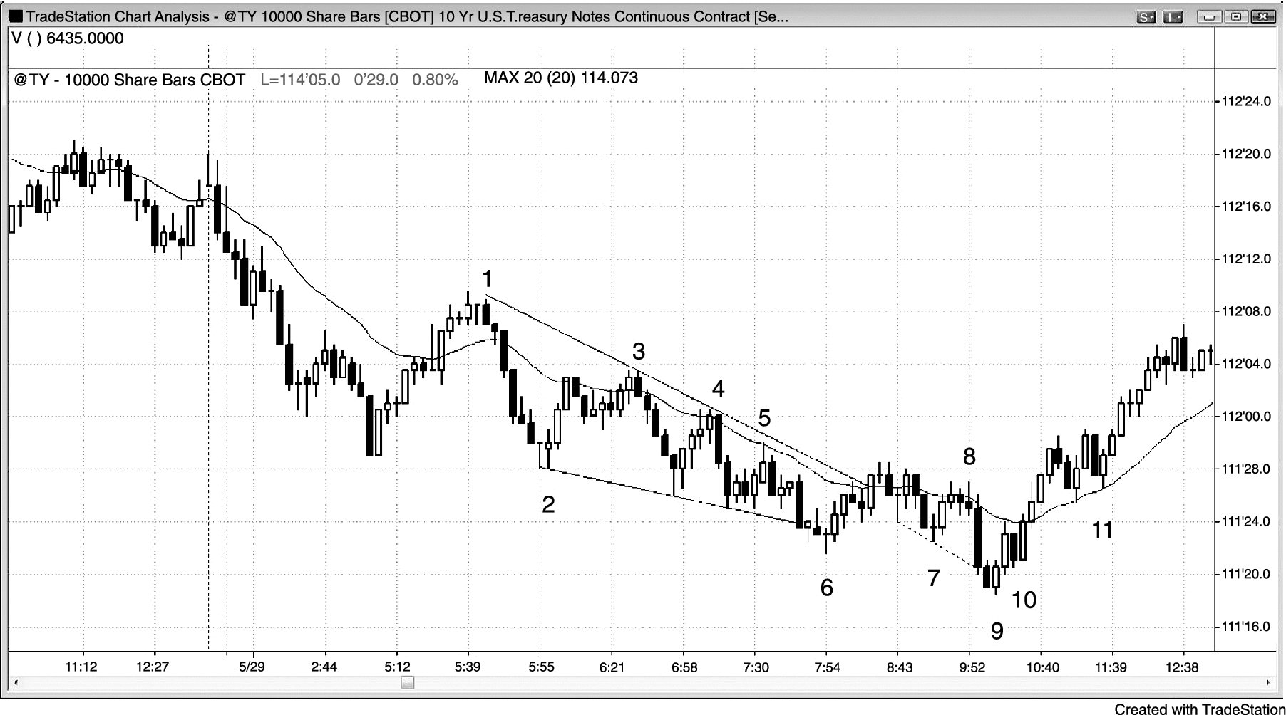
FIGURE 21.1 T-Note 10,000-Share Chart

Slide 2
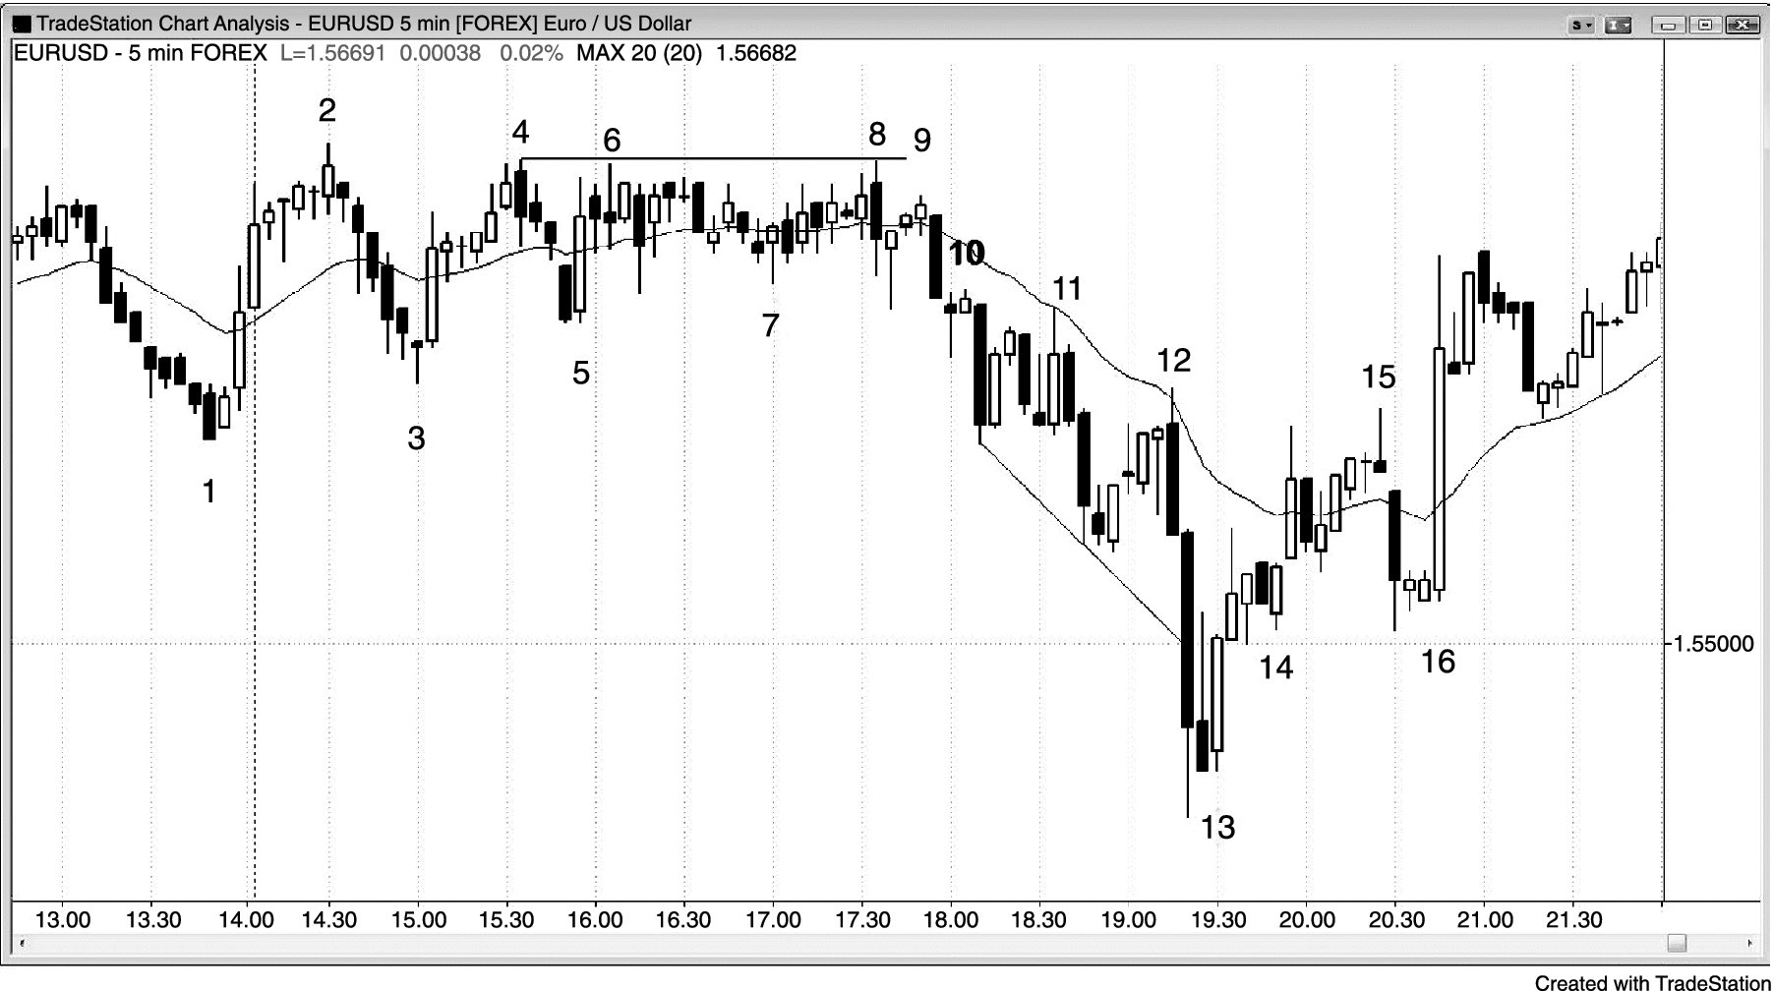
FIGURE 21.2 Strong Open in the EUR/USD

Slide 3
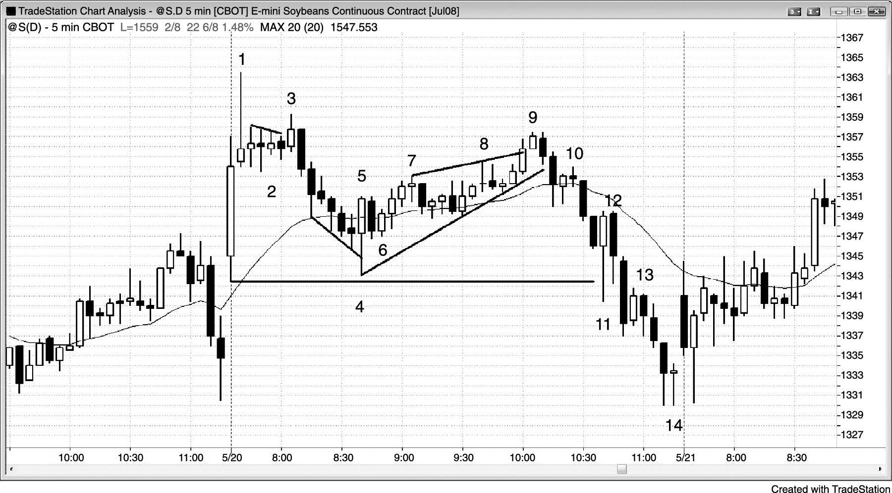
FIGURE 21.3 Soybeans Buy Climax on the Open

Slide 4
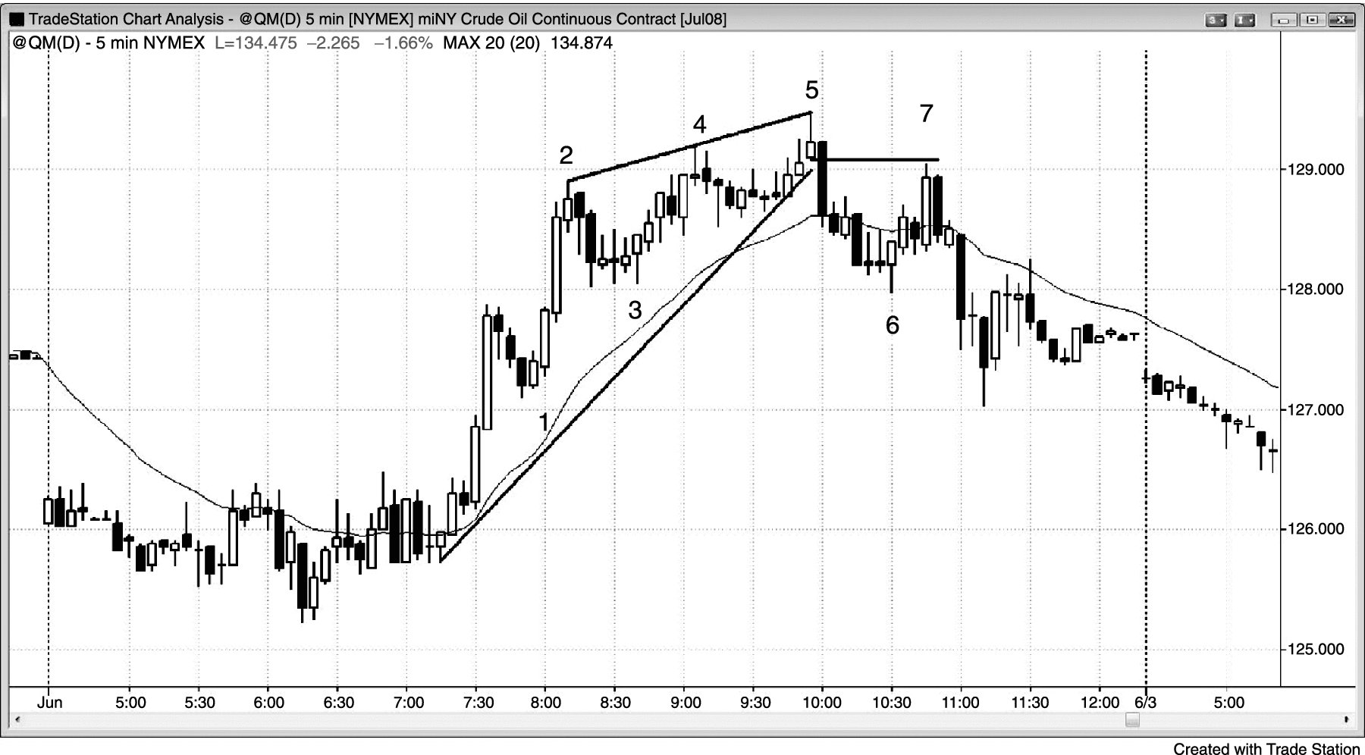
FIGURE 21.4 Crude Oil Wedge Top

Slide 5
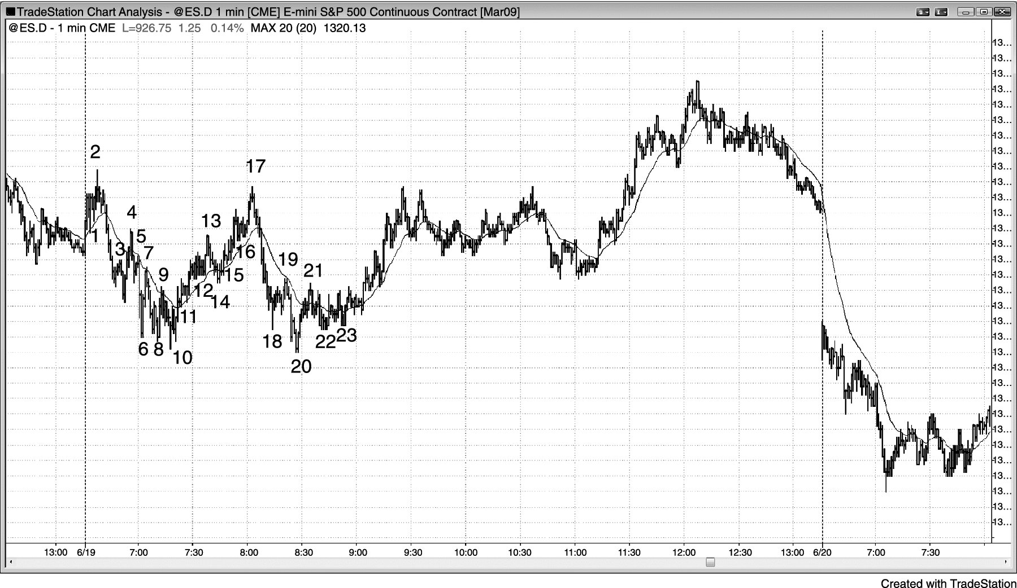
FIGURE 21.5 Scalps on a 1 Minute Chart

Slide 6
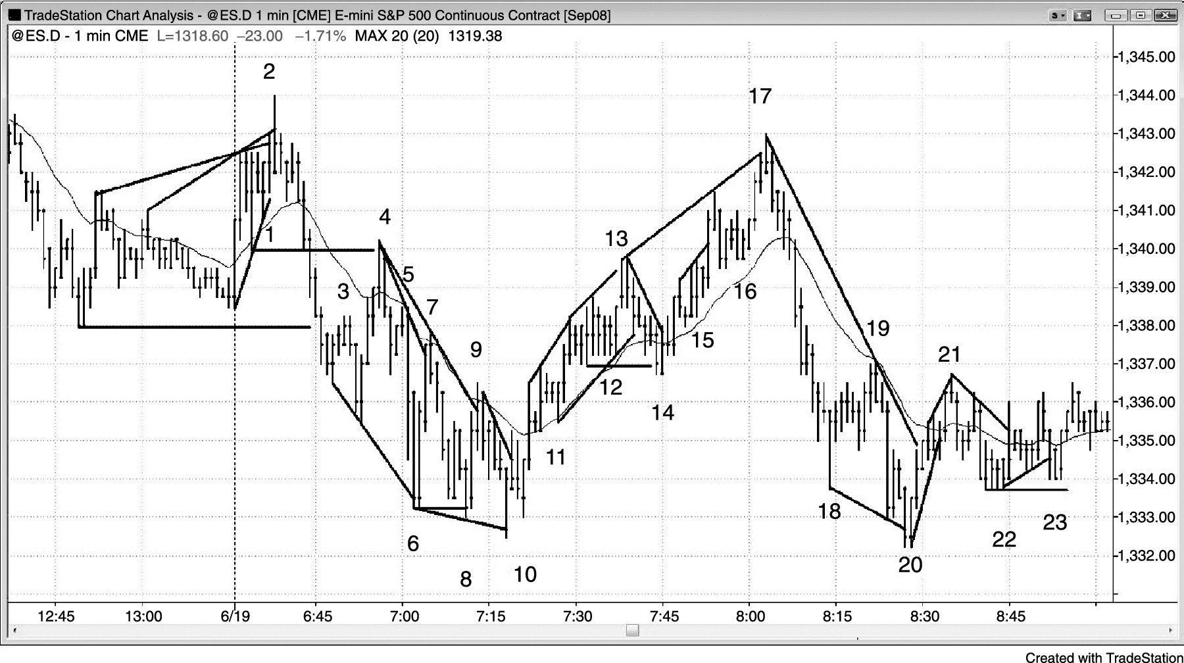
FIGURE 21.6 Scalps on the Open on a 1 Minute Chart

